Slide 1

INDIAN BANKS’ ASSOCIATION
Medical Scheme for
Retired Bank Employees designed by
K. M. Dastur Reinsurance Brokers Pvt. Ltd.
Presentation on Policy Terms ,
Conditions And
Some Frequently Asked Questions

Slide 2
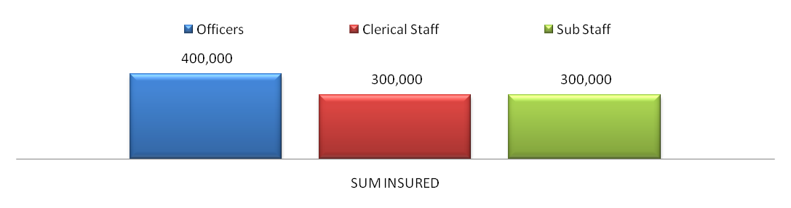

IBA Policy Benefits – Definitions
Family Definition :
  Employee + Spouse
Sum Insured :
  Hospitalization and Domiciliary Treatment coverage
Date of Joining the Scheme :
  All Retired Employees to be covered from the date of their joining the scheme. Once a retired employee exits the scheme, he will not be allowed to rejoin later.
  For additions/deletions during policy period, premium to be charged/refunded on pro rata basis. Refund of premium will not be applicable in case of claims incurred.

Slide 3
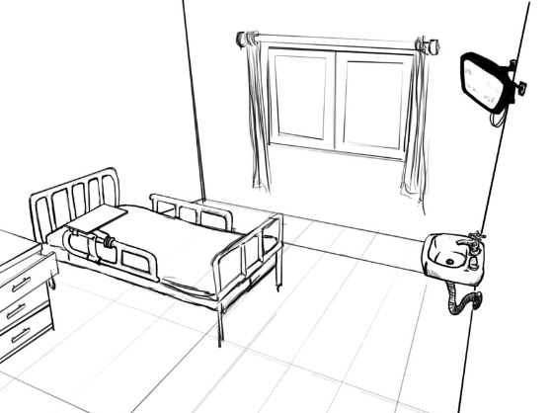
IBA Policy Coverage's
Age Limit :
There is no age limit for joining the scheme.
Premium Collection :
Banks to pay the premium of retired employees in one stroke. Retired employees to pay the premium to Banks.
Room Eligibility :
  Room Rent Including Room and boarding charges Rs.5000/- per day.
  ICU Charges Rs.7500/- per day

Slide 4

IBA Policy Coverage‘s (cont.)
30 Days
Pre- Post Hospitalization :
  Expense incurred during the Pre-hospitalization and Post-hospitalization period will be covered for 30 days prior to hospitalization and 90 days after discharge respectively.
Day Care Treatment :
  Expenses on Hospitalization for minimum period of a day are admissible. However this limit will not apply in case of stay in hospital of less than a day for those ailments listed in Schedule A and;
  a) If the surgery is undertaken under General or Local Anesthesia in a hospital / day care Centre in less than a day because of technological advancement and;
  b) Which would have otherwise required hospitalization of more than a day.
Admission Date
Discharge Date
90 Days

Slide 5
IBA Policy Benefits – Waivers of Exclusions
Pre-existing and other waivers :
  Pre-existing diseases / Ailments are covered
  All diseases and ailments are covered under the policy without any waiting period
Change of Treatment :
  Change of treatment from one system of medicine to another is covered in the policy if recommended by treating doctor.
Congenital Anomalies :
  Congenital Internal/External diseases, defects and anomalies are covered under the policy.
Other diseases :
  Diseases such as Benign prostatic hypertrophy, hysterectomy, menorrhagia or fibromyoma, hernia, fistula in ano, piles, sinusitis, asthma and bronchitis are covered under the policy, Psychiatric and psychosomatic diseases are payable with or without hospitalization.

Slide 6
IBA Policy Benefits
Ambulance Charges :
  Ambulance charges are payable up to Rs.2500/- per trip on production of the receipt.
  Taxi and Auto expenses in actual, maximum up to Rs.750/- per trip, on production of a receipt will be payable. (Claim upto Rs.300/- will be paid without receipt on declaration basis).
  Ambulance charges actually incurred on transfer from one center to another center due to Non availability of medical services/medical complication shall be payable in full.
Accidents :
Covered
  Treatment taken for Accidents will be payable on hospitalization.
  Accidents of a serious nature are also covered on outpatient basis in Hospital up to Sum Insured.
Not Covered
  Minor injuries like Contused, Lacerated wound requiring suturing.
  Minor burns or injury requiring dressing.

Slide 7
IBA Policy Benefits
Taxes and other Charges :
All Taxes, Surcharges, Service Charges, Registration charges, Admission Charges, Nursing, IV Administration charges will be payable.
Chargers for diapers and sanitary pads are payable if necessary as part of the treatment.
Charges for hiring a nurse/attendant during hospitalization will be payable only in case of recommendation from the treating doctor in case ICU/ICCU.
Neo natal nursing care or any other case where the patient is critical and requiring specialized nursing care.
Alternative Therapy :
  Reimbursement of expenses for hospitalization and only domiciliary treatment under the recognized system of medicines, viz. Ayurveda, Unani, Sidha, Homeopathy, Naturopathy, if such treatment is taken in a clinic/hospital recognized by the central and state government.
Physiotherapy charges :
  Physiotherapy charges shall be covered as recommended by attending doctor even if taken at home during the period of post hospitalization.

Slide 8
IBA Policy Benefits
Advanced Medical treatments , ARMD and Other Similar Ailments :
Treatment for Age related Macular Degeneration (ARMD)
  Age related macular degeneration (Neovascular) will be covered if diagnosis confirmed with flourescein angiography. Intravitreal injection of Lucentis, Macugen, Avastin or photodynamic laser therapy will be payable.
Rotational Field Quantum magnetic Resonance (RFQMR)
  It will be covered if used for advanced osteoarthritis and for treatment of Cancer.
Enhanced External Counter Pulsation (EECP)
It will be covered for specific Indications –
    Angina or Angina equivalents with poor response to medical treatment and when patient is unwilling to undergo invasive revascularization procedures.
    Ejection fraction is less than 35%.
    Co-morbid conditions co-exist which increase the risk of surgery e.g. DM, Congestive Cardiac Failure, Cor. Pulmonale, Renal dysfunction.
    Ischemic or Idiopathic Cardio myopathy.

Slide 9
IBA Policy Benefits – Domiciliary Cover
Medical expenses incurred for listed domiciliary ailments on out Patient basis are covered under the policy and shall be reimbursed to the extent of 100%.
The cost of Medicines, Investigations and consultations, etc. in respect of listed domiciliary treatment shall be reimbursed for the period stated by the specialist and/or the attending doctor and/or the bank’s medical officer in Prescription.
If no period stated, the prescription for the purpose of reimbursement shall be valid for a period not exceeding 90 days.

Slide 10

IBA Policy Benefits – Notice of Claims
Notice of Claims :
Planned : Prior to admission to hospital
Emergency : Within 7 days of admission to hospital
  The Notice may be submitted to the exclusive Call center set up by the UIIC TPA, at the UIIC TPA Help Desk, or , the Bank Claims Hub.
  Submission of Claim Documents :
      All claim documents should be submitted within 30 days from the date of discharge.
  Submission of Domiciliary claim :
  All documents of Domiciliary claim to be submitted once a month by the 10th of the next month. e.g. The total bills of January to be submitted on 10th Feb 2015.

Slide 11
IBA Policy Exclusions
War like Operations :
  Injury/disease directly or indirectly caused by or arising from or attributable to War, invasion, Act of Foreign enemy and War like operations (whether war be declared or not).
  Circumcision unless necessary for treatment of a disease not excluded hereunder or as may be necessitated due to an accident.
Vaccination or inoculation.
Cosmetic Surgeries :
Change of life or cosmetic or aesthetic treatment of any description is not covered.
Plastic surgery other than as may be necessitated due to an accident or as part of any illness.
Cost of spectacles and contact lenses, hearing aids.

Slide 12
IBA Policy Exclusions
  Dental treatment or surgery of any kind which are done in a dental clinic and those that are cosmetic in nature.
  Convalescence, rest cure and General debility.
  Obesity treatment and its complications including morbid obesity.
  Treatment for Venereal disease.
  Intentional self-injury.
  Use of intoxication drugs / alcohol.
  Immune System :
    All expenses arising out of any condition directly or indirectly caused to or associated with Human T-Cell Lymphotropic Virus Type III (HTLB - III) or lymphadenopathy Associated Virus (LAV) or the Mutants Derivative or Variation Deficiency Syndrome or any syndrome or condition of a similar kind commonly referred to as AIDS.

Slide 13
IBA Policy Exclusions
Hospitalization for Investigations only :
  Investigation which are not pertaining to the primary ailment, for which hospitalization is required are not covered unless recommended by attending doctor.
  Vitamins and Tonics :
    Expenses on vitamins and tonics unless forming part of treatment for injury or disease as certified by the attending physician.
  Nuclear Weapons :
    Injury or Disease directly or indirectly caused by or contributed to by nuclear weapons / materials.
  Non-Medical Expenses :
    Charges for telephone, television, /barber or beauty services, food charges (other than patient’s diet provided by hospital), baby food, cosmetics, tissue paper, toiletry items and similar incidental expenses.

Slide 14
Frequently Asked Questions
Q. Who is a United India TPA ? And How will I know my United India TPA?
A Third Party Administrator is An IRDA licensed TPA who is engaged by the Insurance Company in Servicing the Health Insurance Policy. Your United India TPA will send you a complete kit consisting of various guidelines for availing cashless and submission of claims.
Q. What services would a United India TPA be offering?
As the authorized United India TPA servicing the policy following services are offered:
  A personalized Identity Card will be issued to each member and dependents to avail of Cashless facilities in all the network hospitals of United India TPA.
  Cashless service facility at network hospitals upto the authorized limit as per policy terms & conditions.
  Claims processing of reimbursement claims.
  24 X 7 Call Center service through toll free number.
  Website giving Online facility for generation of E-card, claim intimation, filing, upload and tracking of claims and Payment Status.
  Help Desks at various locations across the country.
  Grievance Portal to solve all enquiries and grievances within 24 hours.

Slide 15
Frequently Asked Questions
What is a Health Identity Card?
A Health Identity card will be given to you by United India TPA. It will consist of the name of your bank , Your Employee ID, a Unique Identification Number , the Policy period and the United India TPA contact details. The Health card will help in availing cashless facilities in the United India TPA network hospitals. The Health kit will be delivered to designated regional offices of each bank.
What is my recourse, if ID card is not given to me. ?Will I be able to avail cashless facilities without the same?
Please check with your HR , if you are an enrolled member with the policy. If not kindly make provisions to enroll yourself. Once the HR sends the Information to the Insurance company the United India TPA will send you the ID card Kit. If you are an enrolled member please call up the United India TPA call centre and they shall assist you with the same. Cashless cannot be availed without the health ID card.
What is the procedure of Applying for a New Health ID card in case of loss?
Along with the ID card a welcome letter will be given to you with your login ID and password. This will help you to go on the United India TPA website and download an E-card which will work similar to the Health ID card.

Slide 16
Frequently Asked Questions
What Is Cashless Facility and How do I avail Cashless?
Cashless Facility is a benefit extended by the Insurance Company through a United India TPA wherein the insured has the option to get admitted to a Network hospital without the burden of payment of the Hospital Bill. The entire bill is settled directly by the insurance company subject to terms and conditions of the policy.
  Cashless can be availed by;
  a) Approaching the Bank Claim Processing Hub
  b) Directly Approaching the Network Hospital
What is the Procedure to be followed if we approach the Bank Claim Processing Hub?
The Insured can approach the Bank Processing Hub in order to avail cashless services. The Process is as under:
  Employee approaches the bank processing Hub with the details of his hospitalization(The name of the hospital , the admission date , the ailment and the estimated cost
  The bank officer guides him to the United India TPA Help Desk.
  The Help Desk enters the information and prepares a letter of Authorization
  The Help Desk gives a copy of the Authorization letter to the employee and simultaneously sends a copy to the hospital.
  The employee can get admitted to the hospital by showing the Authorization letter to the hospital.

Slide 17
Frequently Asked Questions
What is the Procedure to be followed for Cashless directly with the Network Hospital?
Cashless can be availed at the United India TPA network hospital. The procedure mentioned below needs to be followed while availing Cashless at hospitals.
  Choose network Hospital from updated United India TPA network list of hospital on the website.
  Show United India TPA ID card and collect Pre-Authorization form from the hospital.
  Fill up personal details and the rest to be filled up by the hospital treating doctor along with contact number.
  Hospital will send the fax/e-mail to United India TPA.
  The United India TPA shall process the claim as per policy terms and conditions and send an approval letter to the hospital.
  Get admitted, take treatment and get discharged without payment of bill except for non payable items.
  Please ensure claim form is filled and duly signed and final bill is signed, before discharge.
  Payment will be made to the Hospital/Nursing Home directly by United India TPA.
Will I Get Cashless facility in a non-network hospital?
No. Cashless facility will only be available in a network hospital. However in cases of emergency we may consider providing an advance to the patient.

Slide 18
Frequently Asked Questions
What are the documents required to avail Cashless facility?
Cashless facility is available only in network hospitals. The following documents will be required before issuing cashless Authorization Letter.
  Duly filled, signed & stamped Pre Authorization Form from the hospital.
  Investigation reports & previous consultation papers (if any).
  Photo ID proof.
  Health ID number/policy number/employee number (Please mention on the AL form and provide a copy of Health ID card).
Does cashless hospitalization mean getting treatment free of cost?
Cashless hospitalization does not mean that the treatment is free of cost.
Any expenses that are not payable under the insurance policy will not be authorized during hospitalization and the same will have to be borne by the patient.
Does cashless hospitalization cover all medical expenses?
Charges for telephone, television, barber or beauty services, food charges (other than patient’s diet provided by hospital), baby food, cosmetics, tissue paper, toiletry items and similar incidental expenses are not payable. All the other charges related to the treatment are covered as per the terms & conditions of the policy.

Slide 19
Frequently Asked Questions
What is Claim Intimation? Do I have to Intimate to United India / United India TPA in case I do not avail cashless facility? .
Claim Intimation is to be given (Telephonically/e-mail/fax/online intimation) prior to the Hospitalization or in case of emergencies immediately upon hospitalization but prior to discharge). If the Hospital you opt for is not on the Panel of United India TPA, you may get admitted to the hospital and submit the claim for reimbursement. In such a case, The hospital should satisfy the criteria of hospital as defined in the policy.
How to avail Reimbursement of claim? / Procedure of Reimbursement Claim?
The process is listed below:
  Get admitted to the hospital, take treatment and pay the bill after collecting all the original documents from the hospital.
  Insured can get admitted in any hospital (Network / Non Network).
  Claim documents to be submitted to Help Desk, Bank Claim Processing Office or nearest United India TPA office as per the convenience of the employee.
  The claim is processed on the basis of the terms and conditions laid down in the policy, and NEFT will be done directly to the employee.

Slide 20
Frequently Asked Questions
Is there any scope of Repudiation of Claim?
If the ailment is not covered in the terms and conditions of the policy, the claim may be repudiated. (For details of the policy terms and condition, Kindly log onto the TPA website). Also in the event of fraud, abuse, misrepresentation and non disclosures. In case of Repudiation, the claim will be first put up before the committee and then repudiated.
What documents are needed for processing claims that have to be reimbursed?
Following documents are required for processing reimbursement claims:
  Claim Form duly filled and signed by the claimant.
  Final Bill & Discharge Card from the hospital in original.
  First consultation letter/initial investigations supporting the diagnosis prior to hospitalization.
  All relevant bills and receipts in original
  Medicine/chemist bills supported by prescriptions in original.
  Original receipt and diagnostic test reports to be supported by a letter from the consulting doctor prescribing such tests.

Slide 21
Frequently Asked Questions
What is pre-post hospitalization & how much amount / limit / number of days are covered for the same?
Pre- Hospitalization: Pre – Hospitalization means relevant medical expenses incurred like consultations, diagnostic tests, 30 days prior to hospitalization and related to the hospitalization claim.
Post – Hospitalization: Post – Hospitalization means relevant medical expenses incurred up to 90 days from the date of discharge and related to the hospitalization claim.
What is the time limit for submission of documents in case of reimbursement claims?
All the documents need to be submitted within 30 days of discharge. For the post hospitalization - 120 days from date of discharge. The post hospitalization claim will be limited to the treatment for 90 days after discharge.

Slide 22
Frequently Asked Questions
Q. Whether dismissed employees, those opting for VRS etc come under the definition of the retired employees?
Individual Banks can decide whether these categories of employees are to be extended the benefits of the scheme. United India will cover retired employees as per data submitted by bank.
Q. Whether all dependents of retired employees will be covered under the scheme?
In case of retired employees only employee and spouse will be covered.
Q. If an employee retires during the currency of the policy, will he or she continue to get benefits of serving employee till expiry of policy?
Yes.
Q. Whether annual health check up expenses are covered?
No. This is not part of the scheme approved in the bipartite agreement.

Slide 23
Frequently Asked Questions
Q. Is there any upper age limit for retired employees?
No. There is no upper age limit.
Q. If retired employees join in the scheme and subsequently opt out, can they rejoin later?
No. If the retired employee opt out of the scheme they cannot rejoin later.
Q. What is time limit for retired employees to join?
We can give the time limit of three month from the date of advertisement informing retired employees about the scheme.
Q. If husband and wife are working in same or different banks will they be covered separately for sum insured of 4 lacs or 3 lacs each as applicable?
Yes. Each will be covered as a separate employee.

Slide 24
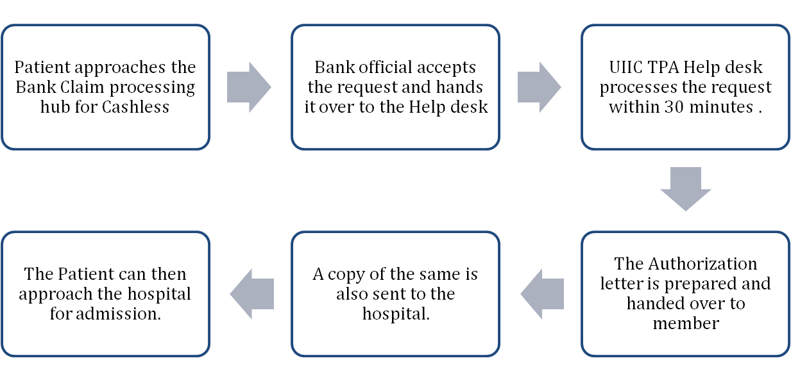

Cashless Processing
Member approaches Bank

Slide 25
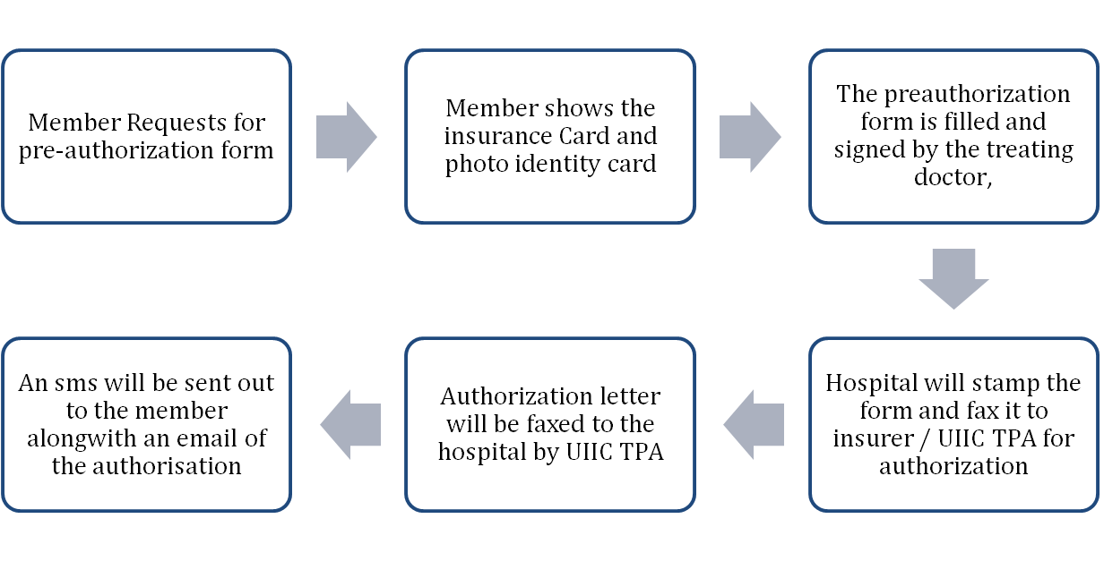
Cashless Processing
Member approaches Network Hospital

Slide 26
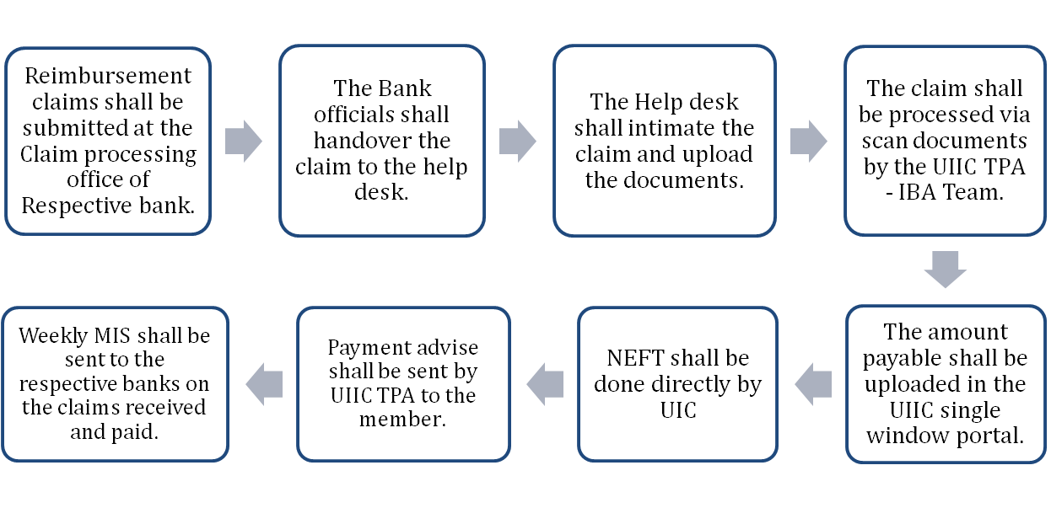

Reimbursement Processing
Member approaches United India’s TPA

Slide 27
Reimbursement Processing
The existing process of submission of reimbursement claims to nodal offices of member banks to continue.
The UIIC TPA helpdesk shall review and collect the documents for further processing.
Alternatively Scanned Documentation can be uploaded online by individuals for faster processing and courier the hard copy.
Once the document is uploaded, Claim intimation number will be generated online.
Employees will be intimated via an SMS for the claim number.
Communication to the insured and its family members in case of deficiencies in documentations along with a robust method of constant reminders via Emails and SMS.

